Slide 1


Building trust through culture, values, and actions
Our success is built on strong environmental, social, and governance (ESG) practices. These three elements drive us to innovate for our customers, create a thriving environment for our team members, and work towards ambitious goals that deliver for our customers and the planet.
This approach empowers us to:
Prioritize safety above all else
Take care of our team members
Embrace diversity, equity, and inclusion (DEI) so everyone feels appreciated and valued
Deliver excellence and value for our customers and stockholders
Act with integrity in all that we do
Support our communities
Help shape a better world
Grow profitability to reinvest in our team members and business
Our ESG Report highlights our progress and commitment to these principles:
147 million gallons of jet fuel avoided through our aircraft fuel conservation and fleet modernization efforts
9,884 alternative fuel and electric vehicles (EVs) in service
34 locations generated on- and off-site solar energy 60% of reported solid waste diverted to recycling facilities
27% of FedEx management employees globally and 36% of board members were women
37% of FedEx management employees in the U.S. and 29% of board members were racially or ethnically diverse
$44.5 million provided in tuition assistance, supporting over 12,800 team members
$9 million invested in nonprofits aligned with our DEI commitment to build more equitable communities
98% of team members completed assigned compliance training courses in FY23
$35.3 billion indirectly contributed to global net economic output
$18.6 billion in goods and services acquired from diverse and small business suppliers in the U.S.
Source: 2024 ESG Report

Slide 2



FedEx Cares
FedEx Cares:
FedEx Cares is our global community engagement program and one way that we live out our purpose of connecting people and possibilities. Our goal is to help make the world a better place through in-kind shipping, volunteering our time and expertise, and charitable giving.
Our focus:
Delivering for Good
Transporting precious cargo
Global Entrepreneurship
Sustainable Logistics
Picture Proof of Planting
Humanitarian Relief

Slide 3
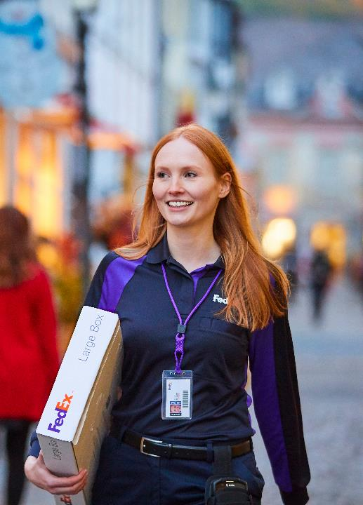




Ethisphere names FedEx as one of the 2024 World’s Most Ethical Companies®
“This is a great honor for FedEx, and we are pleased to be among this select group of companies with exceptional compliance programs and commitments to advancing business integrity for the second year in a row.” — Justin Ross, Chief Compliance Officer of FedEx Corporation
Recognized for the 2nd consecutive year
FedEx is the only honoree in the Transportation industry
Companies must provide 240+ proof points on their culture of ethics; environmental, social, and governance (ESG) practices; ethics and compliance program; diversity, equity, & inclusion; and initiatives that support a strong value chain
A panel of experts spend thousands of hours vetting and evaluating applicants
Learn more

Slide 4

FedEx earns top 20 spot on the Fortune World’s Most Admired Companies List
“This is a testament to the incredible dedication of our team members, who move FedEx and the world forward by delivering both transportation and digital solutions to make supply chains smarter for everyone.” — Raj Subramaniam, President and CEO of FedEx Corporation
Chosen from the highest-revenue companies in each industry in 29 countries
24th consecutive year FedEx has earned a top spot
Ranked 17th company overall
Learn more

Slide 5
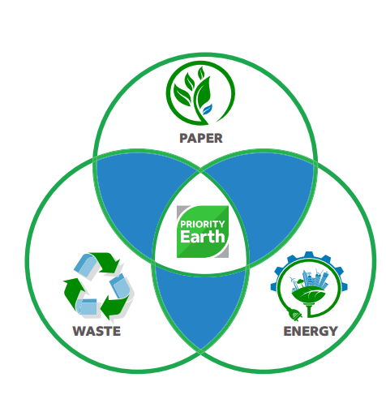
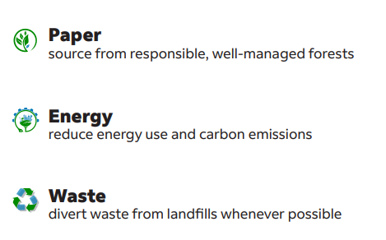
Sustainability
Connecting the world responsibly and resourcefully by meeting today’s needs without compromising future generations’ ability to meet theirs.
FedEx Office Initiatives
FedEx Office’s sustainability strategy is focused primarily around three key PAPER areas:

Slide 6

Paper
Our Commitment
Utilize a Forest-Based Paper Product Procurement Policy that guides us to purchase paper from responsible, well-managed forests.
How do we do it?
Wide selection of sustainable paper. 100% recycled, tree-free and third-party certified paper options.
Enable customers to promote their sustainability efforts. Sustainable signs and graphics offerings, including sustainably certified banners and large format rolls, recyclable banners and media boards.
Stock sustainable paper options. Sustainably sourced and recycled paper options for purchase in stores.

Slide 7

Energy
Our Commitment
Focus on better understanding our energy consumption and finding ways to reduce our energy use and carbon emissions.
How do we do it?
Implemented an Energy Management System (EMS) across our network. Control and monitor energy consuming devices to reduce energy consumption.
LED lighting. Installed in nearly 1,600 of our stores, allowing us to cut our energy use and carbon emissions.
Online ordering. Allows customers to click instead of driving to save gas and reduce carbon emissions. We also print closer to the final destination, avoiding emissions from shipping.

Slide 8

Waste
Our Commitment
Make a significant effort to reduce waste generated as a result of our operations and divert waste from the landfill, whenever possible.
How do we do it?
Partner with waste vendors. Allows us to divert waste from landfills from our stores where possible.
Confidential shredding services. Allows customers to drop off documents for shredding and recycling.
Our IT Asset Disposition program. Allows us to responsibly cleanse, reuse, and recycle IT assets.
Canon drop-off spot. Allows Canon customers to recycle personal inkjet cartridges.
Electronic Document Storage. Allows customers to preview and proof documents online to save on reprints and paper waste.
Sustainable Shipping Supplies. FedEx-branded envelopes(100% recycled paperboard) and packaging (mostly recyclable and contains recycled materials).

